Slide 1
Master Thesis: Defense Techniques
for Model Extraction Attacks on Deep
Learning Models
Fifth Round Discussion
Ridhima Garg (sa46jiza)
Supervisors
Prof. Dr. Christian Riess (FAU, Department of Computer Science)
Mr. Yannick Möll (ITK Engineering GmbH, Data-Driven Software and Sensors)

Slide 2
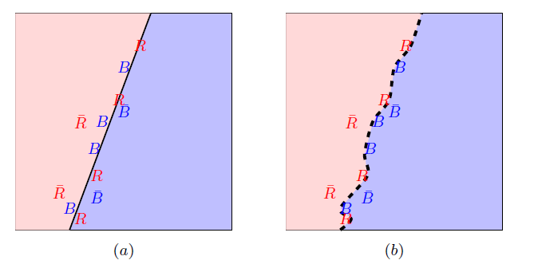
RECAP: FRONTIER STICHING
Defense Technique for Model Extraction Attacks
Invasive: Changes to training process
GOAL: Use the adversarial samples to clamp original model in a unique and harmless way.
(a.) Calculate the true adversary (without bar) and false adversary (with bar). (b.) fine-tunes classifier to classify true ones.
09/22/2023
internal

Slide 3
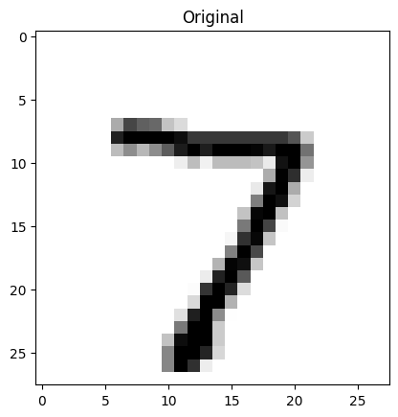
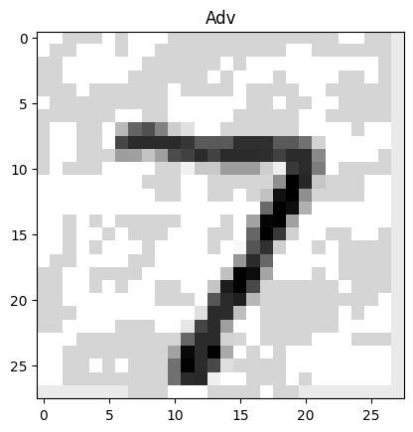
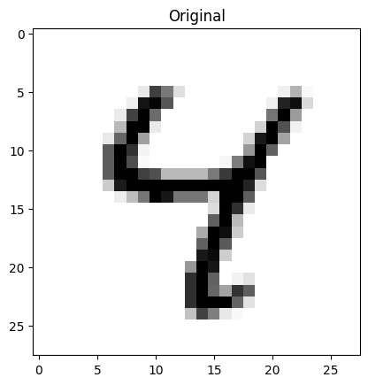
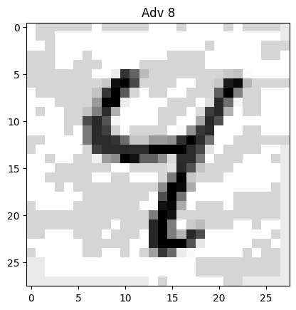
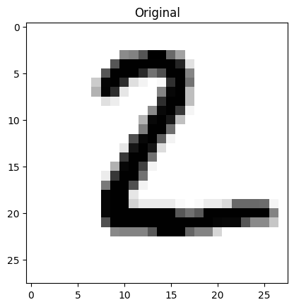
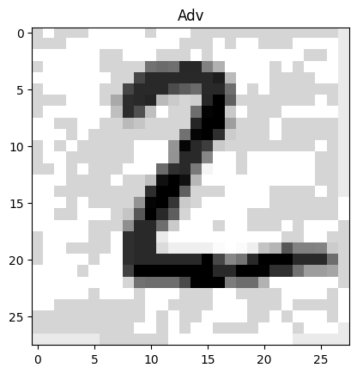
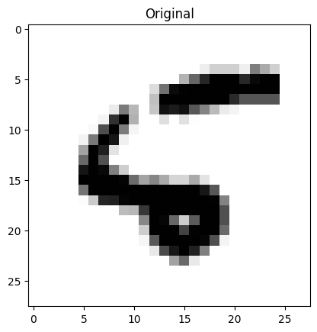
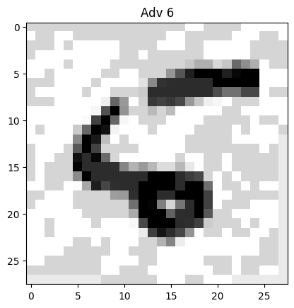
RECAP: FRONTIER STICHING : Watermark samples
Prediction: 7
Prediction: 7 , Goal: 7
Prediction: 4
Prediction: 8 , Goal: 4
Prediction: 2
Prediction: 2 , Goal: 2
Prediction: 8
Prediction: 6 , Goal: 8
False Adversaries
True Adversaries
09/22/2023
internal

Slide 4
PHASE 1: Full adversaries with retraining

Slide 5
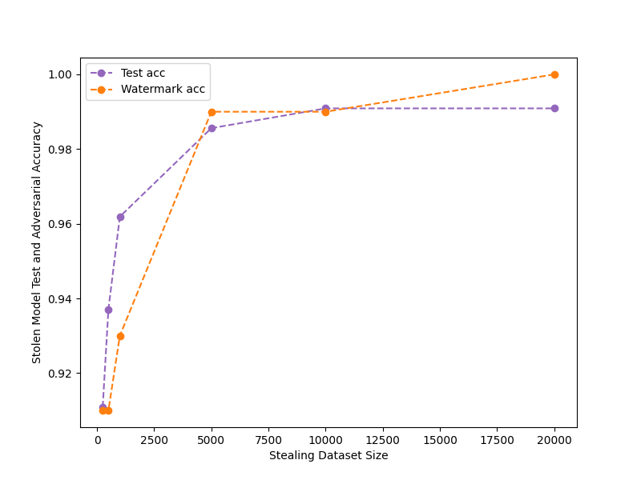
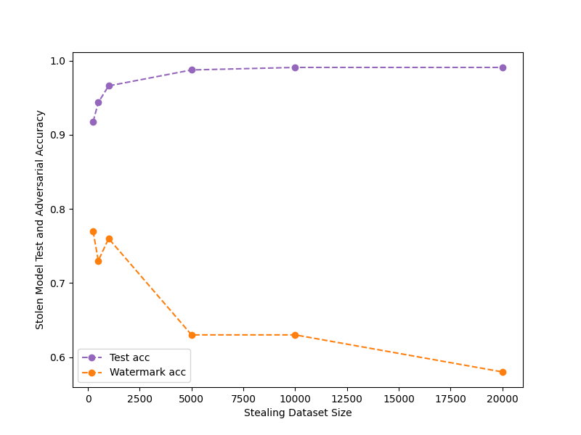
FALSE POSITIVES on MODEL Without FS ON MNIST
Attacking the model (unwatermarked) with epochs: 50, optimizer: adam, lr:0.001
eps=0.1, watermark_size =100
eps=0.25, watermark_size = 100

Slide 6
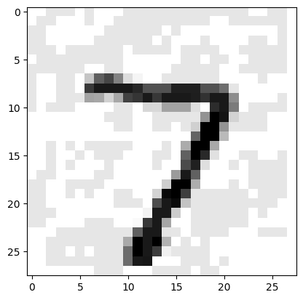
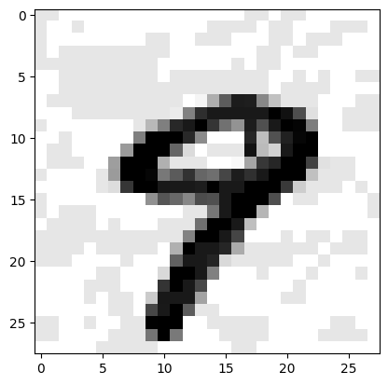
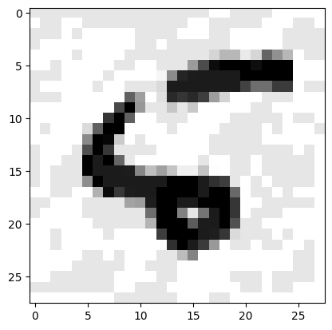
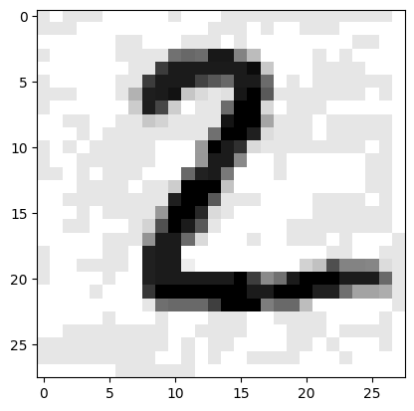
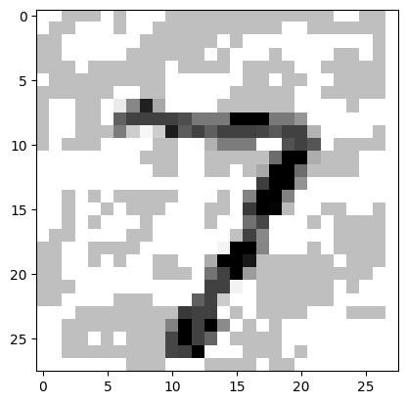

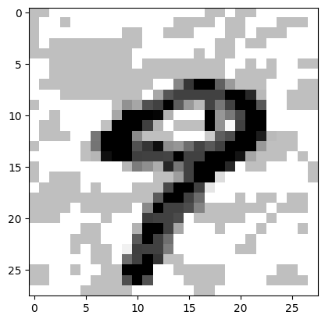
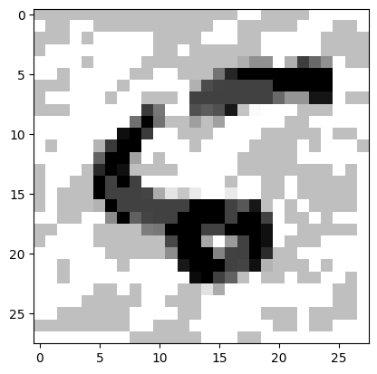
Attacking the model with epochs: 50, optimizer: adam, lr:0.001
eps=0.1
eps=0.25

Slide 7
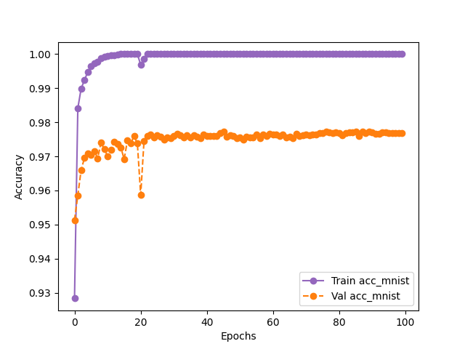
Retraining to watermark model FOR MNIST
Epochs - 100, eps - 0.25, watermark_size - 500
eps=0.25, watermark_size = 500
Dataset | Final Epoch Without Frontier (Victim - test) | Final Epoch After Frontier (using finetuning) (Victim - test) | Final Epoch After Frontier (Victim - watermark)
MNIST | 99.9 | 99.22 ( 0.5%) | 95.99

Slide 8
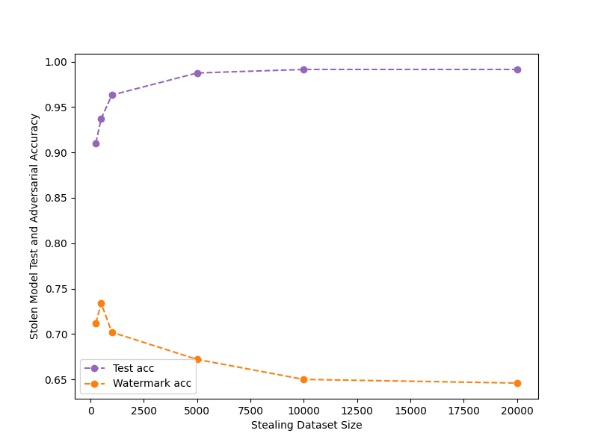
Attacking retrained (watermarked) model
Attack with architecture: MNIST – 2 conv layer, epochs: 50
eps=0.25, watermark_size = 500

Slide 9
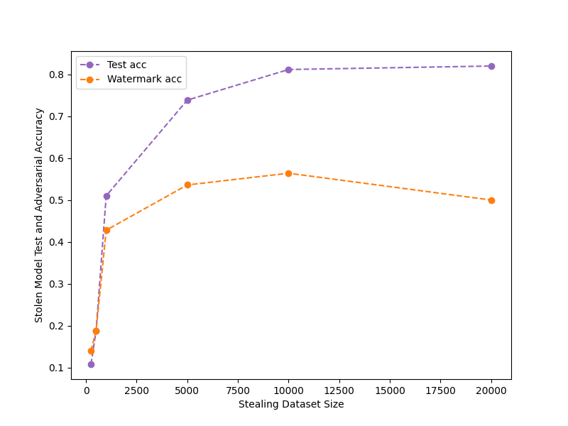
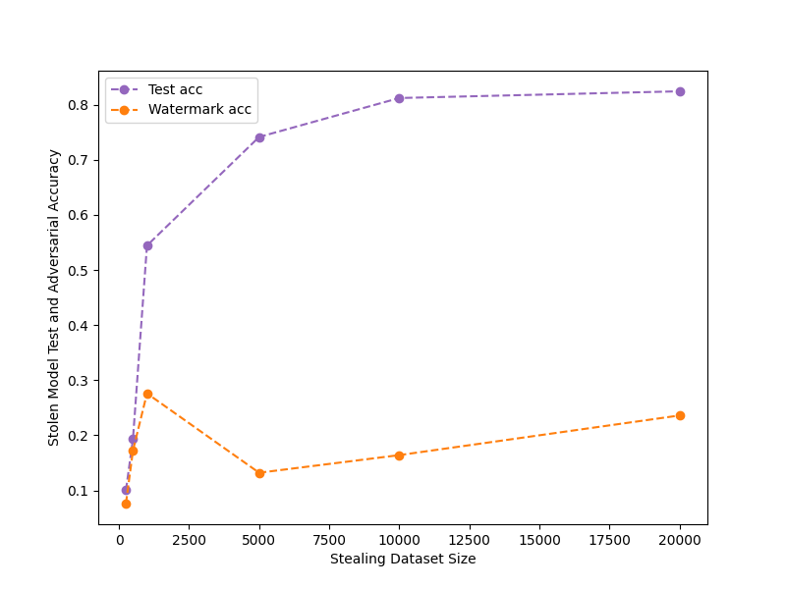
FALSE POSITIVES on MODEL Without FS ON CIFAR10
Attacking the model (unwatermarked) with epochs: 50, optimizer: adam, lr:0.001
eps=0.025, watermark_size = 250
eps=0.1, watermark_size = 250

Slide 10
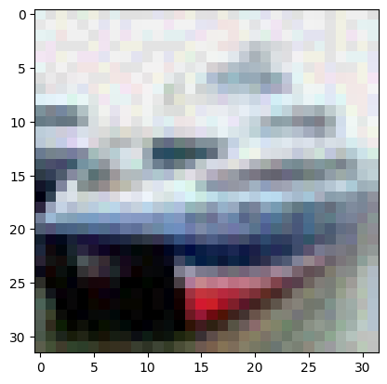
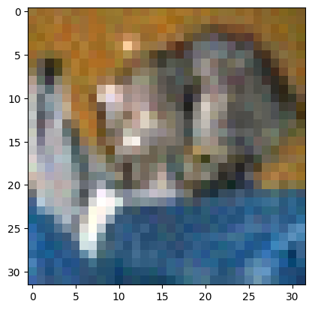
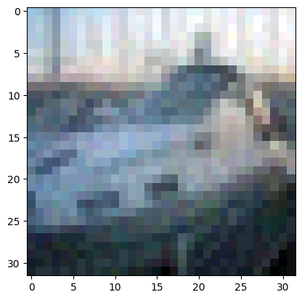
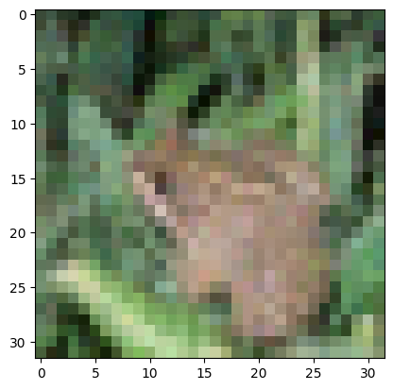
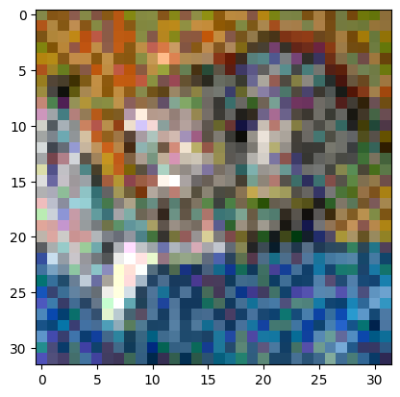
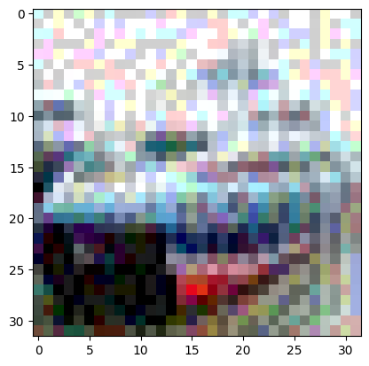
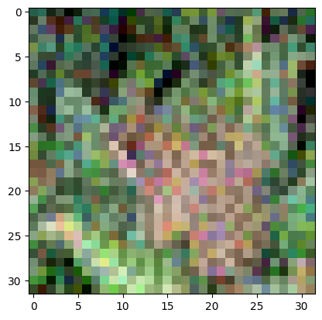
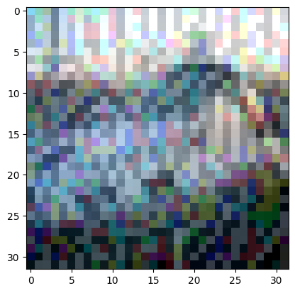
eps=0.025
eps=0.1

Slide 11
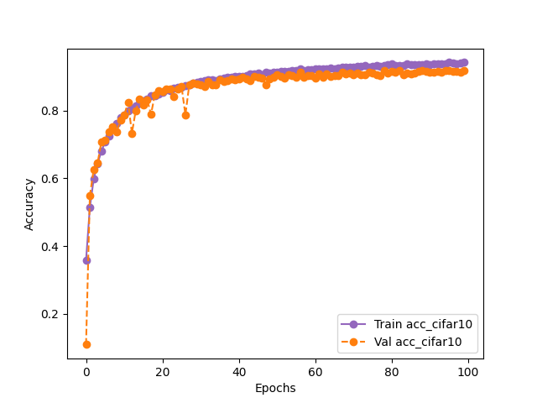
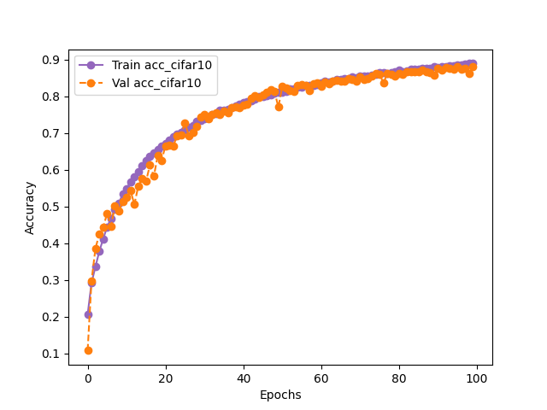
Retraining to watermark model for cifar10
eps=0.025, watermark_size =250
eps=0.1, watermark_size =250
Dataset (eps) | Final Epoch Without Frontier (Victim - test) | Final Epoch After Frontier (using finetuning) (Victim - test) | Final Epoch After Frontier (Victim - watermark)
CIFAR10 (0.025) | 85.4 | 84.86 ( 1%) | 43.99
CIFAR10 (0.1) | 85.4 | 82.02 ( 3%) | 11.99

Slide 12
PHASE 2: True adversaries with retraining

Slide 13
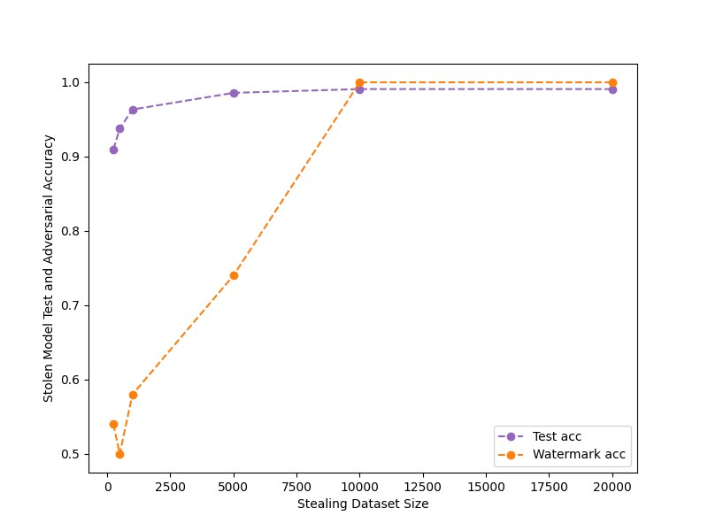
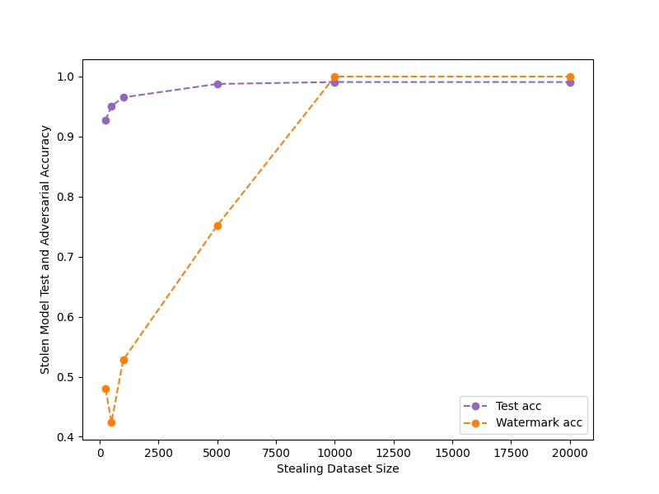
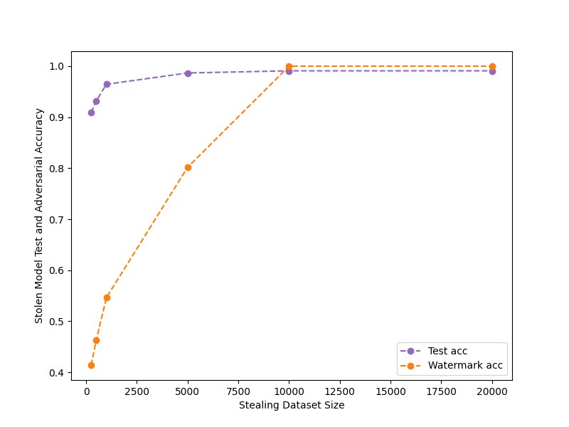
FALSE POSITIVES on MODEL Without FS ON MNIST
Only with true adversaries now.
eps=0.025, watermark_size =100
eps=0.025, watermark_size =250
eps=0.025, watermark_size =10k

Slide 14
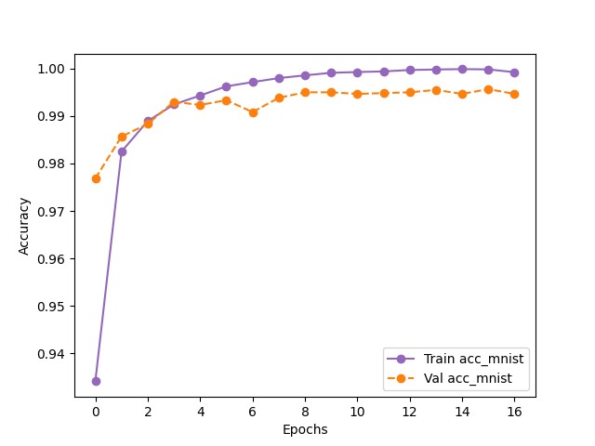
Retraining to watermark model
MNIST: 2-conv layer
Finetuning with noise level (eps = 0.025), lr : 0.001
eps=0.025, watermark_size =100
Dataset | Final Epoch Without Frontier (Victim - test) | Final Epoch After Frontier (using finetuning) (Victim - test) | Final Epoch After Frontier (Victim - watermark)
MNIST | 99.9 | 98.9 ( 1.1%) | 100

Slide 15
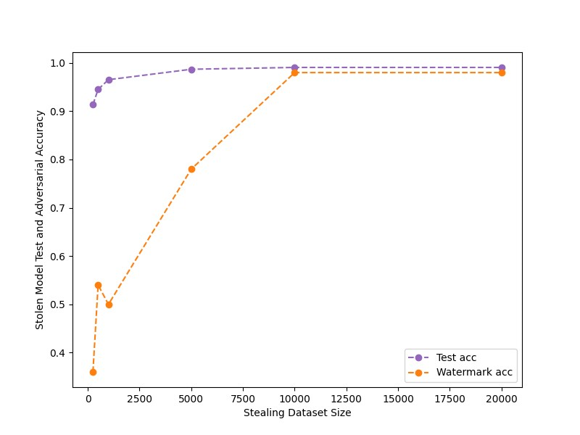
Attacking retrained (watermarked) model
Attack with architecture: MNIST – 2 conv layer, epochs: 50
eps=0.025, watermark_size =100

Slide 16
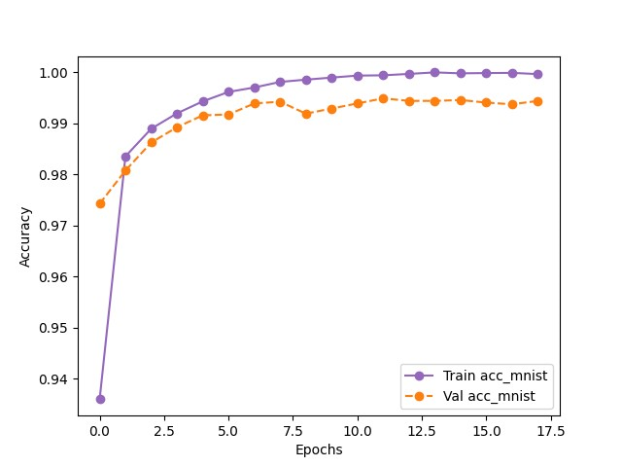
Retraining to watermark model
eps=0.025, watermark_size =10k
Dataset | Final Epoch Without Frontier (Victim - test) | Final Epoch After Frontier (using finetuning) (Victim - test) | Final Epoch After Frontier (Victim - watermark)
MNIST | 99.9 | 99.3 ( 0.5%) | 69.5

Slide 17
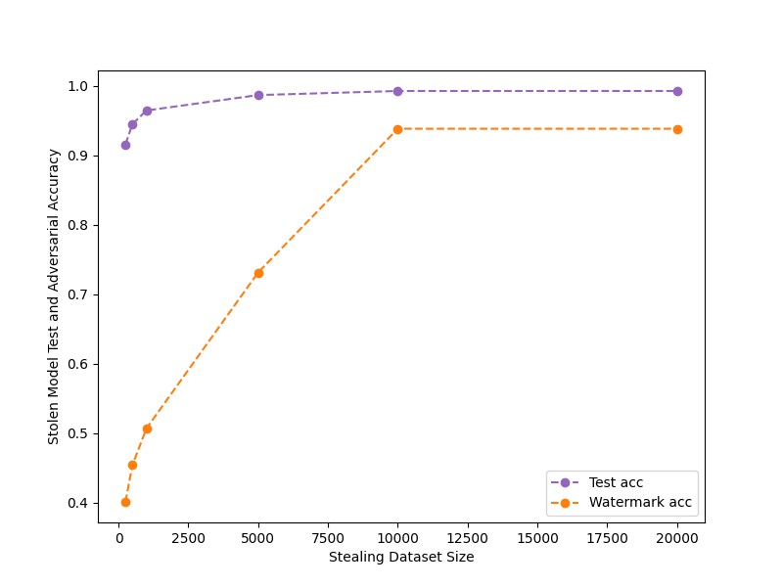
Attacking retrained (watermarked) model
eps=0.025, watermark_size =10k

Slide 18
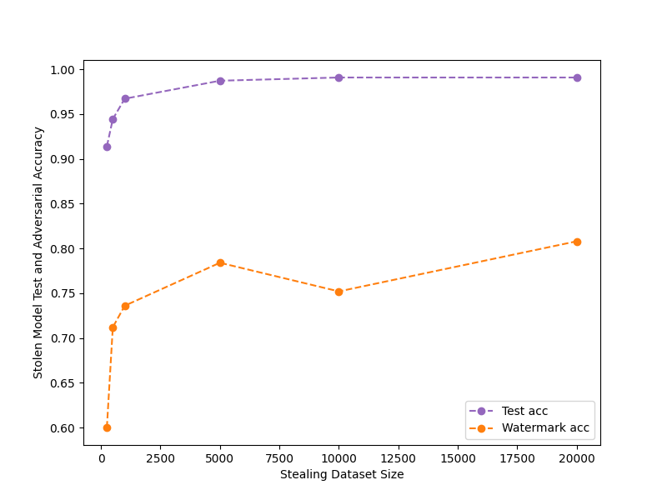
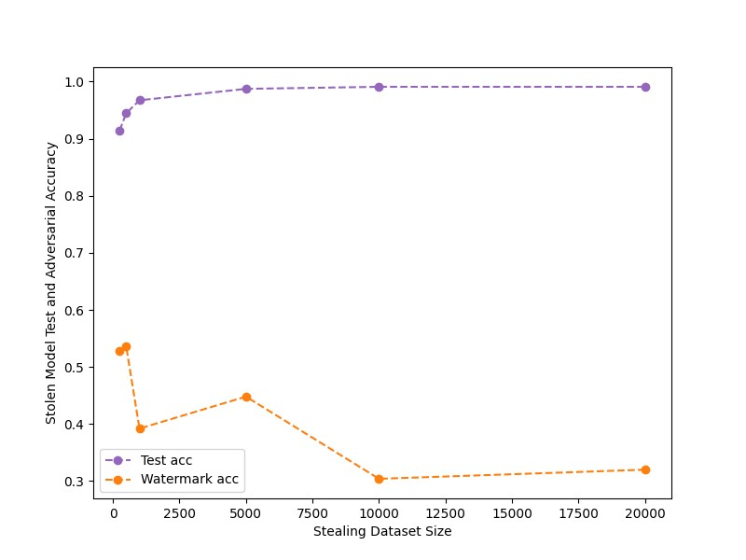
FALSE POSITIVES on MODEL Without FS ON MNIST
More false positives analysis with different noise level.
eps=0.1, watermark_size =250
eps=0.25, watermark_size =250

Slide 19
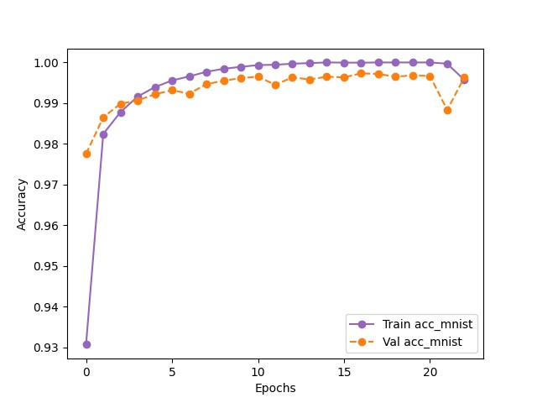
Retraining to watermark model
eps=0.25, watermark_size =250
Dataset | Final Epoch Without Frontier (Victim - test) | Final Epoch After Frontier (using finetuning) (Victim - test) | Final Epoch After Frontier (Victim - watermark)
MNIST | 99.9 | 98.6 ( 1.3%) | 84.6

Slide 20
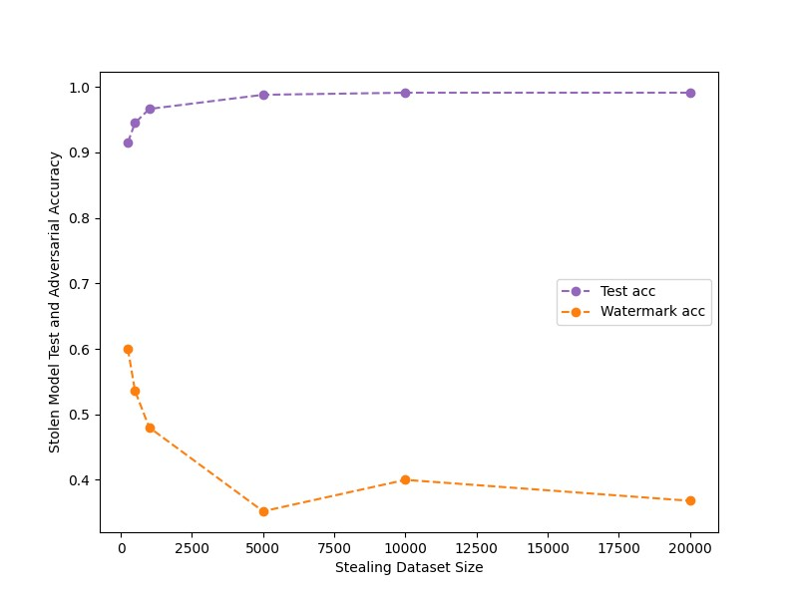
Attacking retrained (watermarked) model
eps=0.25, watermark_size =250

Slide 21
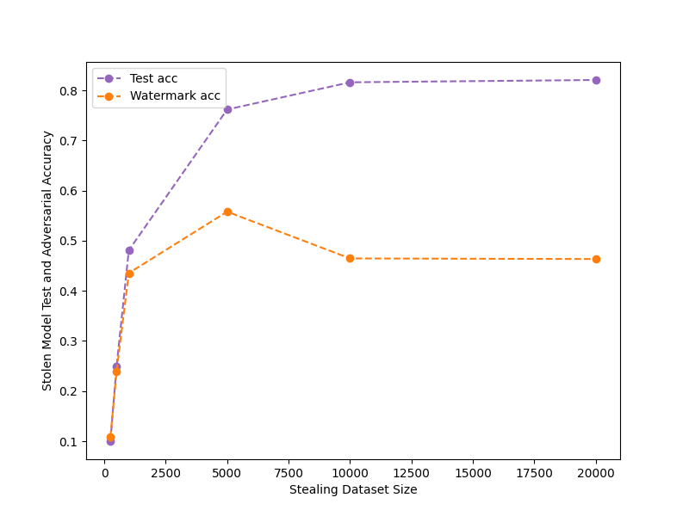
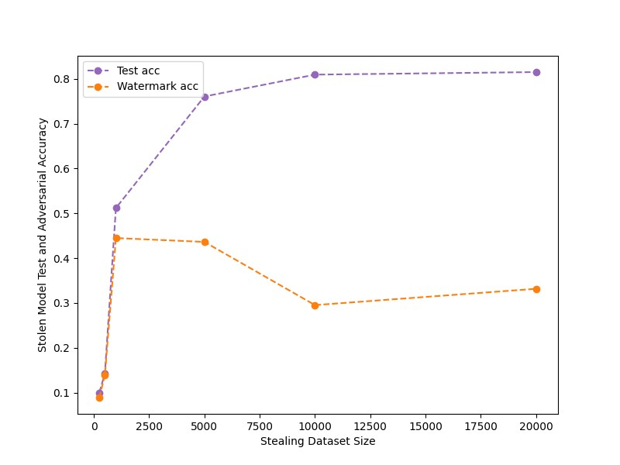
FALSE CLAIM AnALYSIS ON CIFAR10 Shallow NETWORK
Shallow Network : CIFAR10: 3-conv block with batchnorm and dropout
Using only true adversaries.
eps = 0.025
False claim with low confidence
eps = 0.035
False claim with low confidence
09/22/2023
internal

Slide 22
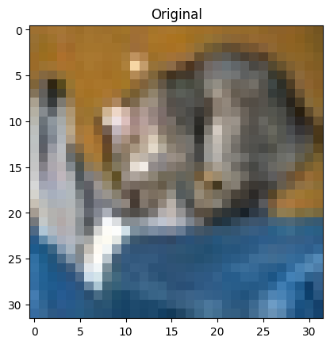

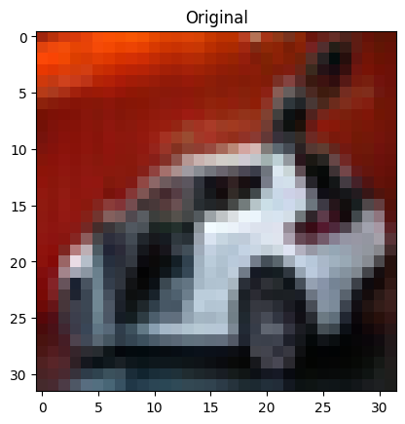

FALSE CLAIM AnALYSIS ON CIFAR10 Shallow NETWORK
eps = 0.035

Slide 23
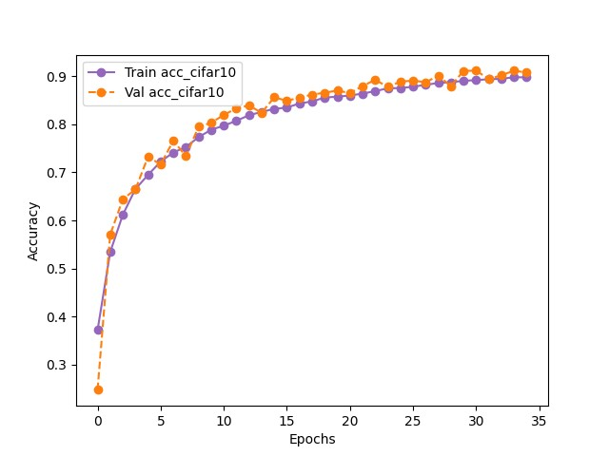
Retraining to watermark model
eps=0.035, watermark_size =100
Dataset | Final Epoch Without Frontier (Victim - test) | Final Epoch After Frontier (using finetuning) (Victim - test) | Final Epoch After Frontier (Victim - watermark)
MNIST | 82.5 | 82.24 ( 0.3%) | 62.0

Slide 24
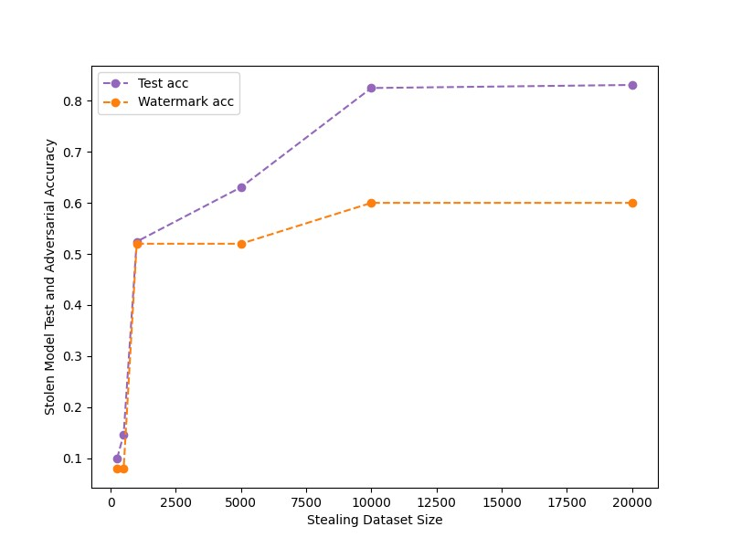
Attacking retrained (watermarked) model
eps=0.035, watermark_size =100

Slide 25

Retraining to watermark model
eps=0.035, watermark_size =10k
Dataset | Final Epoch Without Frontier (Victim - test) | Final Epoch After Frontier (using finetuning) (Victim - test) | Final Epoch After Frontier (Victim - watermark)
MNIST | 82.5 | 82.3 ( 0.2%) | 81.67

Slide 26
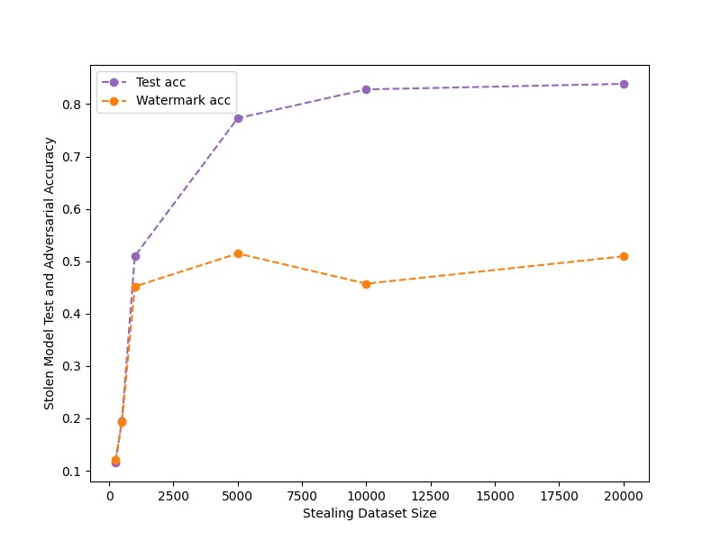
Attacking retrained (watermarked) model
eps=0.035, watermark_size =10k

Slide 27
PHASE 3: True adversaries with Finetuning

Slide 28

Learning rate for finetuning
Finetuning the pretrained network only on watermark samples.
The network will forget the old weights.
To overcome this: the starting learning rate is chosen small, and then smoothly increased (new distribution is learnt at a faster pace, without forgetting the distribution of original samples), and then the learning rate is reduced fast, without too much time to overfit.
Slow start, Fast decay
Learning Rate Schedule

Slide 29


Finetuning to embed watermark
CIFAR10: 3-conv block with batchnorm and dropout
Finetuning with noise level (eps = 0.035),
Learning rate - epoch <= 20 : (0.0001 * epoch) and epoch > 20 : power(2, (epoch -5))
Finetuning with 25 epochs
With learning rate pattern (to increase and decrease)

Slide 30
FIDELITY (DECREASE IN ACCURACY of original model)
Dataset | Final Epoch Without Frontier (Victim - test) | Final Epoch After Frontier (using finetuning) (Victim - test) | Final Epoch After Frontier (Victim – watermark)
CIFAR10 | 82.5 | 74.9 ( 8 %) | 82.9

Slide 31

Attacking Finetuned (watermarked) model
Original Model - CIFAR10 3-conv block with batch norm and dropout
Attack with architecture: CIFAR10 3-conv block, epochs: 50, averaged: 5 runs
Representing the 5 runs by taking the 20th quartile and 90th quartile.
Conclusion
Acc_{wm} (watermark acc) is preserved with more than 90% confidence for every run from a lower to a higher number of queries.

Slide 32

Attacking Finetuned (watermarked) model
Original Model - CIFAR10 3-conv block with batch norm and dropout
Attack with architecture: ResNet , epochs: 50, averaged: 5 runs
Representing the 5 runs by taking the 20th quartile and 90th quartile.
Conclusion
Acc_{wm} (watermark acc) is preserved with good confidence but the variations throughout runs are little high.

Slide 33


FALSE CLAIM AnALYSIS ON CIFAR10 DEEP Network
Deep Network : CIFAR10: ResNet
Using only true adversaries.
eps = 0.015
False Claim
eps = 0.025
False claim with very low confidence

Slide 34




FALSE CLAIM AnALYSIS ON CIFAR10 DEEP Network
eps = 0.025

Slide 35


Finetuning to embed watermark
CIFAR10: ResNet
Finetuning with noise level (eps = 0.025)
Finetuning with 10 epochs
Observation
With a higher number of epochs (e.g. 25) then the model was overfitting only the watermark set and forgetting the previous weights.

Slide 36
FIDELITY (DECREASE IN ACCURACY of original model)
Dataset | Final Epoch Without Frontier (Victim - test) | Final Epoch After Frontier (using finetuning) (Victim - test) | Final Epoch After Frontier (Victim - watermark)
CIFAR10 | 96.05 | 88.91(~89) ( 7%) | 83.2

Slide 37

Attacking Finetuned model
Original Model - CIFAR10 ResNet
Attack with architecture: CIFAR10 3-conv block, epochs: 50, averaged: 5 runs
Conclusion
Acc_{wm} (watermark acc) is preserved between 79% to 85% confidence for every run from lower to higher number of queries.

Slide 38

PRUNING
Without pruning Test acc: 72.06 Watermark acc: 66.68
- Performing pruning on the attacker model.
Pruning level | Watermark Acc | Test Acc
0.025 | 57.34 | 72.0
0.3 | 57.44 | 72.0
0.5 | 52.88 | 72.66
0.75 | 13.39 | 18.06
0.9 | 10.38 | 10.11

Slide 39
FINEPRUNING
Without pruning Test acc: 72.06 Watermark acc: 66.68
- Performing fine pruning with 10 epochs on the attacker model.
Pruning level | Watermark Acc | Test Acc
0.9 | 10.38 | 10.11
Fine Pruning level | Watermark Acc | Test Acc
0.9 | 55.62 | 77.36

Slide 40

Finetuning to embed watermark on MNIST
MNIST: 2-Conv layer
Finetuning with noise level (eps = 0.25)
Finetuning with 25 epochs,
eps = 0.25

Slide 41
FIDELITY (DECREASE IN ACCURACY of original model)
Original Model – MNIST 2-conv layer
Attack with architecture: 2-conv layer, epochs: 50
Dataset | Final Epoch Without Frontier (Victim - test) | Final Epoch After Frontier (using finetuning) (Victim - test) | Final Epoch After Frontier (Victim - watermark)
MNIST (0.25) | 99.08 | 96.49 ( 3%) | 93.8

Slide 42

Attacking Finetuned model
eps = 0.25

Slide 43
PRUNING
Without pruning Test acc: 96.49 Watermark acc: 59.94
- Performing pruning on the attacker model.
Pruning level | Watermark Acc | Test Acc
0.025 | 47.24 | 96.42
0.3 | 47.22 | 96.0
0.5 | 47.82 | 96.76
0.75 | 49.41 | 95.75
0.9 | 33.32 | 84.85

Slide 44
Conclusion
Frontier Stitching
Focus of the work was more on Fidelity metrics instead of watermark preserving.
We fixed the issue by introducing finetuning and using only true adversaries.
Robust towards watermark removal attacks – pruning.
Attack is successful in black box setting.
Not using a probabilistic approach as we are knocking off false positives
Finetuning is more successful in claiming ownership but drop in accuracy (fidelity) of original model is littler higher than retraining.
Results are model and dataset dependent.
General Watermarking
All works have focused on when the attacker is attacking with a large number of queries.
Our work analyzed the watermark presence with varying numbers of queries.

Slide 45
RECAP: Defense on Trained model APPROACHES
Model (trained on task, without watermark)
Model (trained on task, without watermark)
Model (trained on task, without watermark)
Same model architecture
Different model architecture (take input from above model)
Different model architecture (take input from above model)
Model finetuning with watermark set
Model training with watermarking on new model only.
Model training with watermarking keeping some layers unfreezed of base model.
Transfering weights
Finetuning with all layers freezed
Finetuning with some layers freezed
07/28/2023
internal

Slide 46
RECAP: FINAL EXPERIMENT RESULTS OVERVIEW
Datasets – MNIST, CIFAR10
Models – 2/3 layer ConvNet (with and without dropout), ResNet
Dataset (Model architecture) | Defense Method | Model without defense |  | Model with defense (scratch or retraining) |  |  |  | Model with defense (finetuning)
 |  | Acc_{test} | Acc_{w} | Victim Model |  | Adversary Model |  | Victim Model |  | Adversary Model
 |  |  |  | Acc_{test} | Acc_{w} | Acc_{test} | Acc_{w} | Acc_{test} | Acc_{w} | Acc_{test} | Acc_{w}
MNIST (2-Conv) | DAWN / EWE / FS
CIFAR10 (ResNet) | DAWN / EWE / FS
CIFAR10 (3-conv block) | DAWN/ EWE / FS

Slide 47
NEXT Steps AND Discussion
Experiments
Finalizing DAWN
Revisiting Entangled Watermarking – quite a few work is remaining there.
Writing
Outline of the thesis
Template
06/02/2023
internal

Slide 48
09/22/2023
internal

Slide 49
FIDELITY (DECREASE IN ACCURACY of original model)
Dataset | Final Epoch Without frontier (Victim - test) | Final Epoch After frontier (using finetuning) (Victim - test) | Final Epoch After frontier (Victim - watermark)
CIFAR10 | 96.05 | 68.1 ( ~20%) | 75.9
Finetuning with 25 epochs
With learning rate pattern (to increase and decrease)

